Slide 1
Remote Xs: A Case Study of the Remote Access Tool at AIIMS Library, New Delhi
M.K. Vishwakarma
Jahangir Khan & Ms. Neetu Priya
Affiliation: Dr. B.B. D. Library, AIIMS, New Delhi
Email address: aiimsmkv@gmail.com

Slide 2
About AIIMS New Delhi Library
Known as Dr. B.B. Dikshit Library.
2 storey building with the area of 27000 S.F.
Open 24x7 for 365 days except 7 holidays.
It has around 2 Lakh documents including books, journals, thesis, pamphlets etc.
Equipped with latest technology.
Caters the library service to around 3000 registered members.
Using LIBSYS10 for library automation.

Slide 3
Technology available at Library
30 PCs for accessing E-resources.
4 Information Kiosks.
2 LFD for E-orientation and E-notices.
One Projector for seminars/presentations.
Lsmart-RFID card system for users.
3M Security gate with 2 workstations for Issue-Return of documents.
CCTV surveillance systems
Reprography & Printing facility-B/w & Color.

Slide 4
E-Resources of AIIMS Library
E-journals: 1497
E-books: 278
Databases: 15
-These are subscribed e-resources of the leading medical publishers like LWW, Springer, Elsevier,
Wiley, Oxford, Nature, Theime, Sage, T&F etc.
-Library has the subscription of Uptodate, Web of Science, iThenticate, Access Medicine etc.

Slide 5
Electronic Tools to disseminate E-resources
There have many tools provided by the library to its registered members but we are presenting the study on Remote Access tool “RemoteXs”

Slide 6
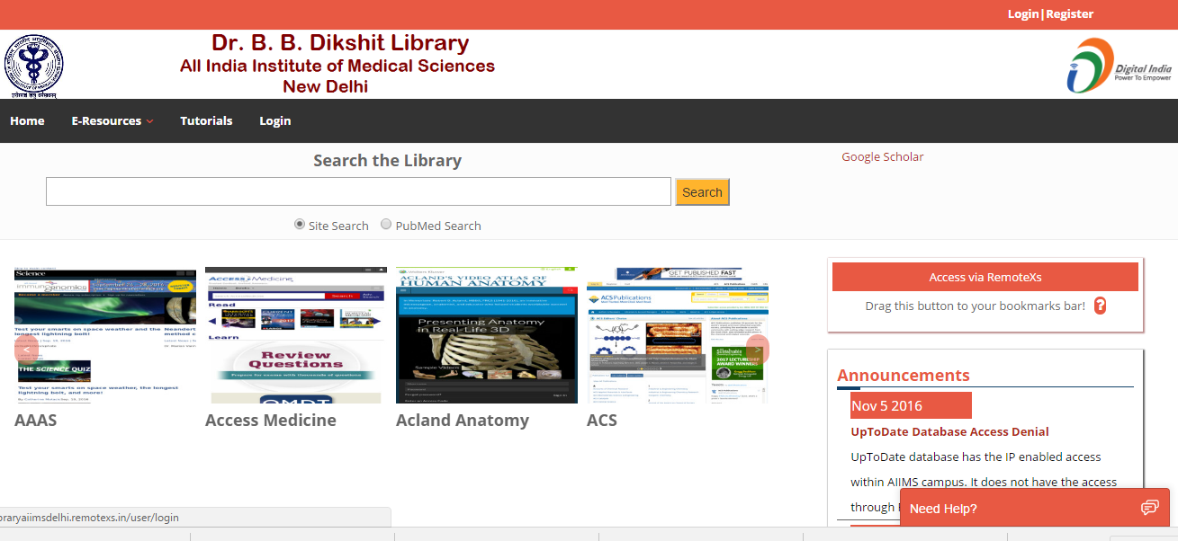
Remote Access Facility
We have a tool called RemoteXs and this the interface of it.

Slide 7
Features of RemoteXs
5 step easy registration process
Personalization of account
E-Resource Listing
IP Authentication
Single Search Box
Data analytics
Live Chat
Announcement option for library

Slide 8
Detailed data in tabulated format (Period: Sept 2016 to Sept. 2018)
S.N. | Category | Users | Logins | Downl--oads | Download Data (MB) | Browsing Data (MB) | Total Data (MB)
1. | Senior Resident | 296 | 7555 | 17127 | 18542.74 | 18025.17 | 36567.91
2. | Junior Resident | 232 | 5709 | 8270 | 9951.58 | 22284.30 | 32235.88
3. | Faculty Members | 139 | 2498 | 4446 | 5401.70 | 5401.47 | 10803.17
4. | Fellow-Academic | 09 | 346 | 726 | 826.01 | 507.61 | 1333.62
5. | Lecturer | 06 | 16 | 21 | 11.75 | 41.97 | 53.72
6. | Librarians | 06 | 64 | 17 | 27.61 | 139.44 | 167.05
7. | Scientist | 04 | 31 | 16 | 1.87 | 57.78 | 59.65
8. | Others | 15 | 618 | 374 | 297.96 | 1159.18 | 1457.14
 | Total | 707 | 16837 | 30997 | 35061.22 | 47616.92 | 82678.14

Slide 9
Bar Diagram-1: Users Distribution
Resident doctors (JR/SR) are the prime users of RemoteXs facility

Slide 10
Bar Diagram-2: User Login (Hits)
Resident doctors are using library e-resources through RemoteXs tool after that Faculty member are using it.

Slide 11
Bar Diagram-3: Number of Downloads
Senior Resident doctors have downloaded the highest number of articles followed by Junior Residents doctors.

Slide 12
Bar Diagram 4:Downloaded, Browsed & Total Data (in MB)
Senior Residents and Faculty Members have browsed the data and equally they downloaded it with maturity. However Junior Residents browsed the more data but downloaded almost half of it which shows the surfing trend.

Slide 13
Pros & Cons of Remote Access tools and technology
Prospects: The institution like AIIMS is saving the money and precious time of doctors with remote access technology and our users of different locations (Delhi NCR) are getting their required electronic resources when they are posted on these locations.

Slide 14
Consequences
On the other side, some of the consequences of remote access technology are also there. Firstly, the interaction between library and users affect badly and it creates the gap amongst them. Mostly the remote access facility is used by the techno savvy users not by common users. Some of the senior health professionals registered them for remote access but could not memories the login ID and password and ultimately get reluctant to use it. There is always a chance of misuse of remote access tool by the registered users by giving the login ID and password to another unauthorized user.

Slide 15
Conclusion
Like other ICTs remote access tools and technologies are the supporting hands of libraries in changing scenario to popularize their subscribed electronic resources and other services. We have to change our shelf with the demand of library users and upcoming technologies for the sustainability of library profession.

Slide 16
Thank You

